Slide 1


VCCS Cardinal Go-Live User Meeting
September 29, 2022
This Photo by Unknown Author is licensed under CC BY

Slide 2

Agenda
  Overview
  Roles & Security
  Employee Self-Service (ESS)
  Human Resources
  TLAM
  Payroll
  Benefits
  Go-Live and Support
  Questions
Notes:
Lauren

Slide 3
Overview
  Meeting objectives
  Communication from Malinda Carter on Monday
  Access to Cardinal will use myVCCS (@email.vccs.edu) credentials
  How to use VCCS guides
  Conversion data cleanup & ongoing data integrity
  Expect the unexpected (Give Grace)
  Support
    Zoom - https://bit.ly/Cardinal-Zoom-Support-GoLiveWeek
    SSC help@ssc.vccs.edu
Notes:
Kimberly (5 min – end by 10:05am)
High level – training in sessions Friday and next week.
Put questions in the chat; mute yourself;
Important information in Malinda’s communication
As interfacing agencies you may receive communications from Cardinal instructing you to clean up your data in Cardinal. This often does not apply to interfacing agencies and you won’t have security to do most of the updates in Cardinal. Instead you will make updates in the VCCS HCM and it will be interfaced to Cardinal. In all cases we need to keep our system in sync with Cardinal so that means data needs to be keyed in VCCS HCM and interfaced to Cardinal
Communication Tuesday about looking for the Cardinal emails – be sure to use 3 page guide from Cardinal when setting up credentials for first time.
How to use guides – who is impacted, process change, impact to VCCS, resources – links to job aids on Cardinal, VCCS process guides, VCCS reference materials (like employee attributes charts)
Cardinal go live fixes spreadsheet

Slide 4

Roles & Security
VCCS HCM 9.2 IS THE SYSTEM OF RECORD
  MUST CONTINUE TO ENTER INFORMATION IN VCCS HCM 9.2 and adhere to the instructions you will receive in this training
Update on VCCS HCM Security Roles
  Removed Correction Mode from existing VCCS HCM roles assigned to the colleges EXCEPT for limited SSC, NVCC and TCC staff
  MUST INSERT EFFECTIVE-DATED ROW TO CORRECT EMPLOYEE INFORMATION
CARDINAL 11-digits EMPLOYEE ID
  The Cardinal Employee ID = 00 prefix + -digit PMIS/BES ID + 00 suffix
  YOU MUST USE YOUR CARDINAL EMPLOYEE ID TO COMPLETE your CARDINAL's User Registration in "OKTA"
CARDINAL Registration and ACCESS
  On October 3rd, all users will receive an email from CARDINAL that includes CARDINAL User Registration Instructions and how to log on CARDINAL at https://my.cardinal.virginia.gov
  Users cannot log in or register until they have received the welcome email on October 3
  It's important to follow the Registration Quick Start Guide (Employee Self-Service ESS) slide)to complete all required registration steps
Notes:
Imad (10min – end by 10:15am)
Can’t do correction mode in Cardinal – have to submit a ticket.
Interfaced transactions will error out (not be loaded in Cardinal) if correction mode is used. SSC, NVCC, and TCC will have limited staff who will have to keep correction mode. Double entry will be needed if correction mode is necessary to key into VCCS HCM and submit a ticket to Cardinal for them to enter with correction mode.

Slide 5
Roles & Security
SECURITY CHANGES
After GO-LIVE
  ESS user access is granted automatically when an employee is hired, and a valid email address is established on the HR Personal Information page.
  Core user access is granted manually by the Cardinal Security team, based on agency requests submitted via the Cardinal Security Access form.
  Cardinal Security Form must be completed by the agency's Cardinal Security Officer (CSO) - See Security | Cardinal (virginia.gov)
Password Tips:
  If a password is entered incorrectly, the user will automatically be locked out after 3 failed attempts
  If the user has forgotten a username or password or locked themselves out, they can complete the Forgot Username/Forgot Password Request
  Users will be required to reset their passwords every 90 days.
System Timeouts:
  Cardinal times out or terminates any session that is inactive for 30 minutes.
  If a user is timed out, any work that has not been saved will be lost.
Notes:
Imad (10min – end by 10:15am)
Can’t do correction mode in Cardinal – have to submit a ticket.
Interfaced transactions will error out (not be loaded in Cardinal) if correction mode is used. SSC, NVCC, and TCC will have limited staff who will have to keep correction mode. Double entry will be needed if correction mode is necessary to key into VCCS HCM and submit a ticket to Cardinal for them to enter with correction mode.

Slide 6
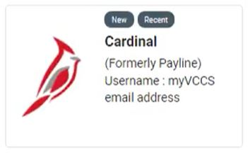

Employee Self-Service (ESS)
Cardinal Icon will be on the myVCCS (myCollege) portal
UserID is 11-digit State employee ID
  Provided in an email from DOA on 9/28/22
    Please be sure to check your email
Cardinal ESS Go Live 10/3
Registration is for VCCS employees (FT/PT, or Adjunct) who do not work for another state agency in a FT capacity
Quick Access Guide
  https://bit.ly/VCCS-Cardinal-ESS-Guide
Notes:
Adina & Nicole (10 min – end by 10:25am)
Talk about the myVCCS icon
Talk about the myVCCS email "@email.vccs.edu"
* future opportunity to not double MFA, coming soon "progressive" elaboration
• *@public.govdelivery.com
• *@cardinal.virginia.gov
• *@doa.virginia.gov
Get DT – Video link to put in here too

Slide 7
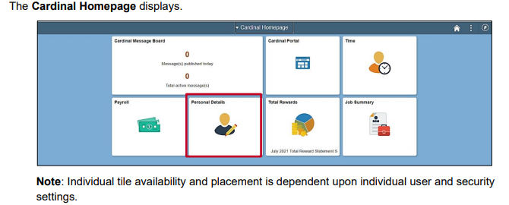
Employee Self-Service (ESS)
What actions can be taken:
View Personal and Job Details (view only)
View Paystubs and W2's (Historical records will be accessed in Payline)
Enroll/Update Direct Deposit Information
Enroll/Update Benefits
Notes:
Adina & Nicole (10 min – end by 10:25am)

Slide 8
Human Resources
HCM or Cardinal?
HCM is the system of record for Employee Data + Absence Management.
  The position, job and personal data from HCM interfaces to Cardinal at 5pm each day.
  *** Future dated transactions will not be interfaced ****
  The interfaces will run in batches each night to determine data changes from the previous run. The data in HCM needs to stay in sync with Cardinal data.
  Cardinal will not accept future data transactions, so the interface will send transactions effective the day keyed and/or next day.
Cardinal is the system of record for Employee Pay + Benefits.
  HR data should not be keyed directly in Cardinal.
  As a standard practice to change any data in Cardinal, the data should be keyed correctly in HCM and interface to Cardinal via the daily interface file(s).
Interfaces
HR006 - Position Data Upload
HR003 - Employee Data Upload
HR162 - Position Data Extract
HR296 - Employee Data Extract
BN271 - Benefits Enrollment Extract
TA756 - Agency Time Entry Upload
PY176 - Payroll Data Extract
Notes:
Carly (20 min – end by 10:45am)
Importance of creating positions first
When an employees moves to a different college do a terminate and a hire
Can’t use correct history – use a new effective date or sequence

Slide 9
Interface File Details – HR006 and HR003
Human Resources​
The HR006 and HR003 interfaces will not contain future effective dated rows.
HR006 (Inbound Interface – To Cardinal)
The purpose of this interface is to upload new positions, update existing positions, add new position default funding distributions, and/or update existing position default funding distributions from agency HR systems into Cardinal HCM.
Agencies will only be able to create/update position default funding distributions for the open Fiscal Year(s).
The interface process will only accept position default funding data for existing positions in Cardinal HCM where the effective status of the position is active.
The HR006 interface will not contain future effective dated rows.
HR003 (Inbound Interface – To Cardinal)
The purpose of this interface is to send daily files that contain additions and changes to the employee personal and job data, then these changes will be applied to the corresponding Cardinal HCM job data and employee tables.
Interface records that are rejected due to invalid action/action reason codes or field values will be written to the error log file and error table. After resolving the error(s) the transactions must be repassed in the following day’s interface file or entered manually into Cardinal.
The HR003 interface will not contain future effective dated rows.
Notes:
Carly (20 min – end by 10:45am)

Slide 10
Human Resources​
Changes in our processes: Action + Action-Reason Code Changes
Business Impacts >
The transition from Commonwealth legacy systems to Cardinal HCM will have significant impacts to the way agencies conduct business. This improves transaction processing efficiency, reduces transaction timing dependencies, and reduces reconciliation issues.
Due to Cardinal Requirements, some VCCS Action and Action-Reason Codes have been created, modified, and/or inactivated. These changes allow VCCS data to interface correctly from HCM to Cardinal.
The Action and Action-Reason Codes trigger a plethora of benefits actions, which must be addressed daily.
Cardinal Action Description | Cardinal Reason Description | Cardinal Action | Cardinal Action-Reason | HRMS Action | HRMS Action-Reason | HRMS Description | Cardinal Comments
Hire | Transfer In Comp Lateral | HIR | XCL | HIR | CVT | Competitive Voluntary Transfer | Transfer in competitive lateral; employee has no historical record in BU.
Hire | Transfer In Non-Competitive | HIR | XNC | HIR | NCT | Non-Competitive Transfer | Transfer in non-competitive; employee has no historical record in BU (DOC, VCCS).
Hire | New Hire | HIR | NEW | HIR | NEW | New Hire - Salaried | Original Appointment.
Hire | New Hire | HIR | NEW | HIR | NWA | New Hire - Wage/Adjunct | Original Appointment.
Hire | Transfer In Promotion | HIR | XPO | HIR | PRO | Promotion | Transfer in promotion; employee has no historical record in BU.
Hire | Transfer In Demotion | HIR | XVD | HIR | DEM | Voluntary Demotion | Transfer in demotion; employee has no historical record in BU.
Hire | Transfer in from Layoff-Card | HIR | XLP | HIR | XLP | Transfer In Layoff Place-Card | Transfer in from layoff with card; employee has no historical record in BU.
Hire | Transfer in from Layoff-NoCard | HIR | XLR | HIR | VOL | Transfer in from Layoff-NoCard | Transfer in from layoff no card; employee has no historical record in BU.
Hire | Transfer In Inter-Agency Reorg | HIR | XRE | HIR | XLR | Transfer in Inter-Agency due to Reorg | Transfer in reassignment; employee has no historical record in BU (DOC, VCCS).
Hire | Hir ORP Ret | HIR | ORP | HIR | ORP | Hir ORP Ret | Hire for ORP Retiree into pooled ORP Position within employing agency (benefits only).
Hire | Reassignment | HIR | HRA | HIR | XRE | Reassignment | Inter-agency reassignment; employee has no historical record in BU (e.g., DOC, VCCS).
Notes:
Carly (20 min – end by 10:45am)

Slide 11
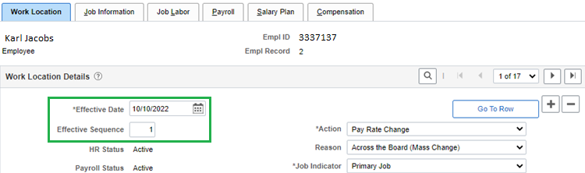
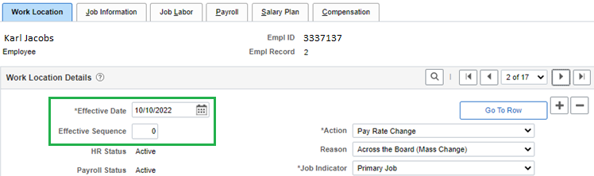
Human Resources​
Changes in our processes: Correct History / Effective Dating
  Cardinal does not allow the use of Correct History.
  Workaround is to “stack” transactions keyed on Job Data to overwrite the original data that interfaced to Cardinal.
  The same effective date would need to be used but the Effective Sequence number would increase.
  This also includes position data changes—transactions must be keyed on Job Data with a change to the Effective Sequence number for the data changes to interface to Cardinal.
  Reminder: after you save a transaction on Job Data, you can click on the notepad icon to add a comment to document specific transaction details.
Notes:
Carly (20 min – end by 10:45am)

Slide 12
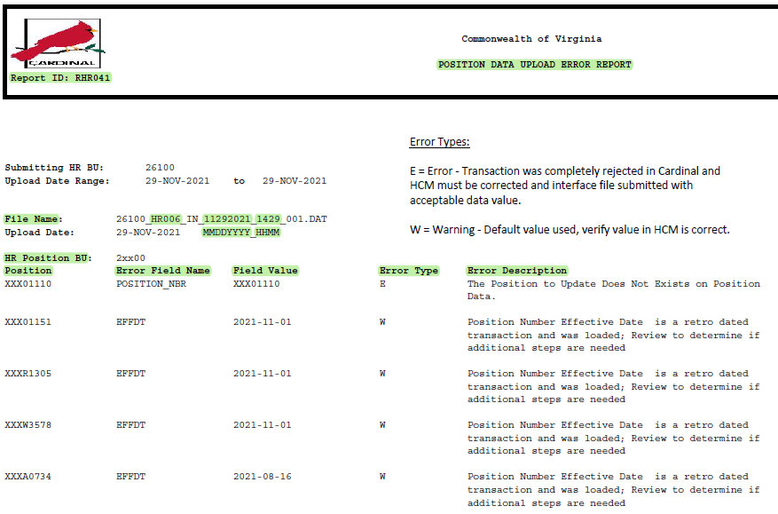
Human Resources​
Changes in our processes: Position Data Upload Error Report
Position Data Upload Error Report
  Based on data submitted via the HR006 - Position Data Upload interface file.
  SSC will receive the error report and engage the colleges as necessary for data corrections.
  Possible Errors/Warnings:
    Position Number is less than 8 characters in length.
    Position Number does not have a status of Active.
    Position Number and/or funding does not exist in Cardinal.
    Required position information is missing from the Add/Update Position Info or the Employee’s Job Data page in HCM.
    Required position identifiers and/or funding data is missing from the Additional Position Info page or the Employee’s Job Data page in HCM.
    If the effective date of the transaction is less than the last/current effective dated row in Cardinal HCM, the transaction will be rejected.
Notes:
Carly (20 min – end by 10:45am)

Slide 13
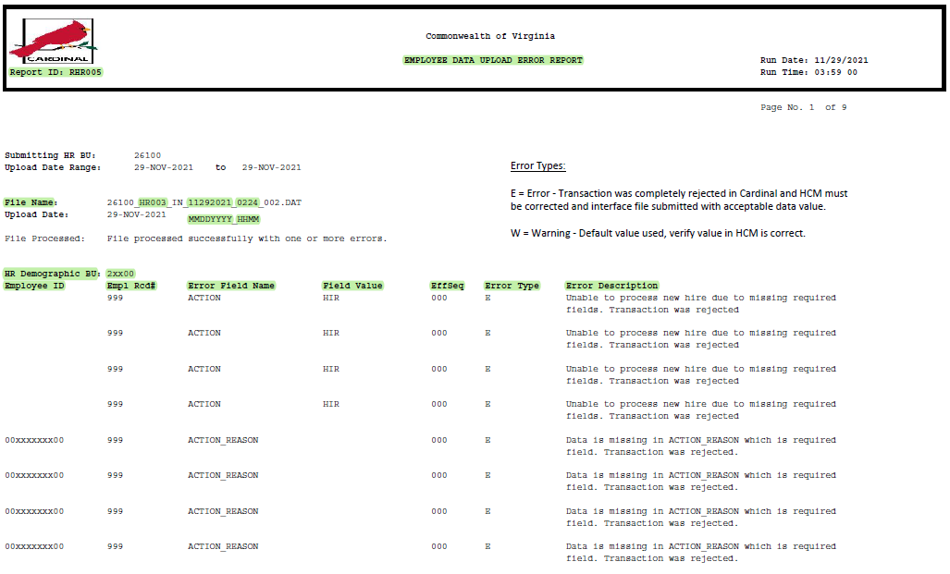
Human Resources​
Changes in our processes: Employee Data Upload Error Report
Employee Data Upload Error Report
  Based on data submitted via the HR003 - Employee Data Upload interface file.
  SSC will receive the error report and engage the colleges as necessary for data corrections.
  Possible Errors/Warnings:
    Incorrect Action or Action-Reason Code is listed on Job Data page.
    Employee is missing a Business or Home Email address on Modify A Person page.
    Position Number does not exist in Cardinal.
    Missing Alternate ID on Modify A Person.
    Missing Comp Rate field on Job Data.
    Missing Job record for Position Number in the file.
    Missing Temp Pay or Military Pay data on Additional Pay Data Entry page, or a mismatch in effective dates between pages.
Notes:
Carly (20 min – end by 10:45am)

Slide 14
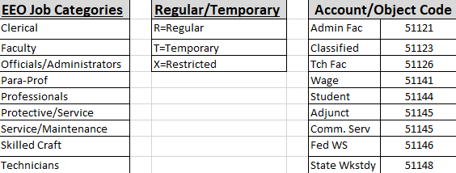
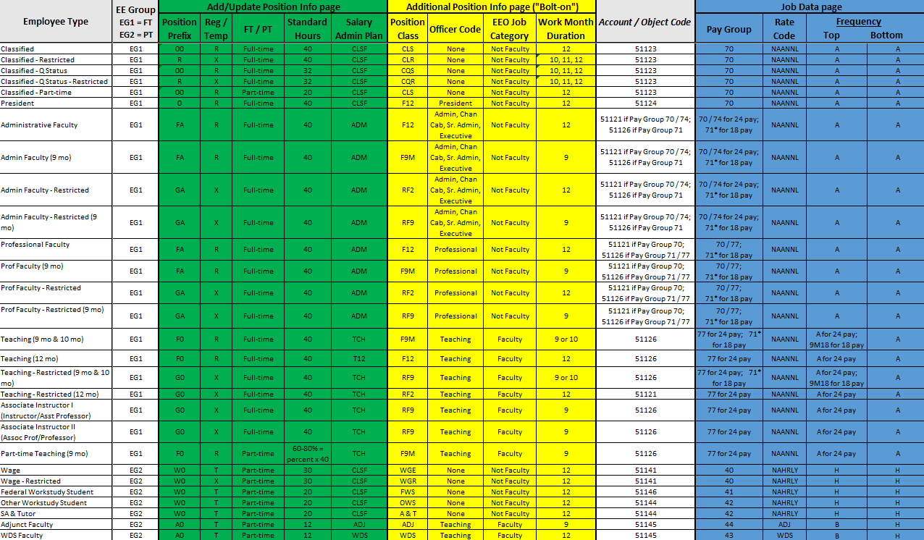
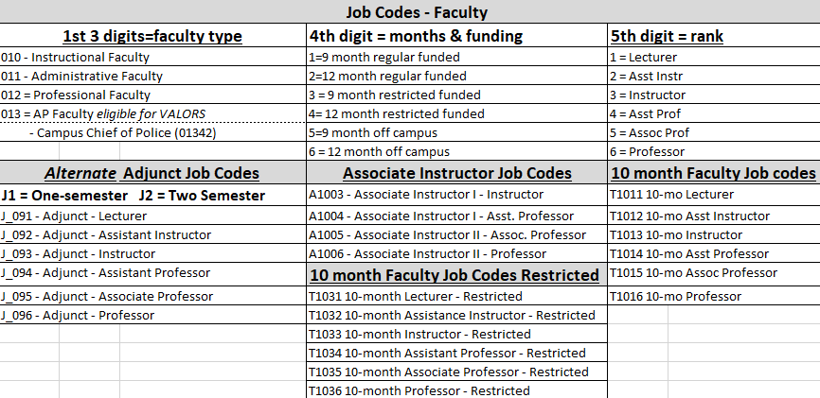
Human Resources​
Changes in our processes: Employee Attributes Chart
Must be followed for data integrity.
Notes:
Carly (20 min – end by 10:45am)

Slide 15
VCCS HCM Standards and Validation Queries
… still matter!
Human Resources​
The standards and queries serve to:
Comply with audit needs from internal and external audit entities.
Service the VCCS by modernizing HR using technology and supplying timely, accurate, workforce data in HRMS and its integrated systems.
Establish a foundation of universal, predictable operating principles for the HR Technology team to efficiently support, build from, and improve continuously.
Further support college as the local process and Standard Owner so they will have in place more efficient and effective operational controls.
Prevent processing errors and warnings associated with the Cardinal Interface files, most importantly with HR006 and HR003.
Notes:
Carly (20 min – end by 10:45am)

Slide 16
TLAM (Time Labor and Absence Mgmt)
TLAM Processing
  Timesheet Entry
    Timesheet Entry will remain the same in HCM. No timesheets should be maintained in Cardinal. Managers and employees will not have access to Cardinal timesheets. Time Administrators will have access to timesheets in Cardinal but should only enter data if approval is granted. All hours submitted on timesheets will interface from HCM to Cardinal.
  Absence Management
    Absence Management (leave entry) will remain the same in HMC. All leave submittals and adjustments will be entered into HCM and will interface to Cardinal. The VCCS will not have the Absence Management module activated in Cardinal. Leave transactions interface only to satisfy timesheet completion required by Cardinal.
Notes:
Dorrisa Carly (20 min – end by 11:05am)
Prior period adjustments will have to be keyed as SPOT pay
Give BW3 and SM pay dates
Need to update timesheets in HCM but payroll will do SPOT transactions
Wage emloyees submitting TA756 weekly – need submission and approval to happen weekly
Validate leave balances before go-live

Slide 17
TLAM (Time Labor and Absence Mgmt)
Entry/Approval Process
  Frequency
    Best practice is for employees to complete timesheets daily.
    The Time & Labor interface for salaried employees will be sent to Cardinal at the end of the pay period and then three business days after the end of the pay period. This does not require any change management for the salaried employee population.
    The interface for hourly employees will be sent at the end of each work week. Submission will be every Thursday and then three business days after the end of the pay period. Employees will be required to submit hours by the end of the workweek and managers will be required to approve by the end of the work week.
    TLAM unapproved notifications will be increased for hourly employees to capture unproved time each workweek. There is no change to salaried employee unapproved notifications.

Slide 18
TLAM (Time Labor and Absence Mgmt)
Entry/Approval Process (Cont'd)
  AM Calendar Processing
    Absence Management Calendar processing schedules for salaried employees may change due to Cardinal requirements. All approved leave submissions will interface to Payable Time with AM calendar processing.
    It is proposed that calendars will be completed on the last day of the pay period to ensure that leave transaction will interface to Cardinal for timesheet completion.
    This will require employees to enter leave transactions when used and managers will be required to approve these transactions by the end of the pay period.
Interface TA756
  All approved Payable Time (including hours submitted on timesheets and non-productive time (leave)) will upload to Cardinal in the TA756 file. This file will capture transactions for hourly and salaried employees for the entire VCCS. It will be submitted to Cardinal at the end of the pay period and then three business days after the end of the pay period for salaried employees and at the end of each work week and three business days after the end of the pay period.

Slide 19
TLAM (Time Labor and Absence Mgmt)
Error Report and Exceptions
  Shared Services TLAM (TA757)
    The TA757 report is an error report that is returned when Cardinal identifies discrepancies with employee data. Many issues returned are specific to employee data. employee’s Payable Time will not process for payment. Most issues are related to Position or Job Data. At this time, the report is returned with all VCCS agencies included, therefore, TLAM will parse the results and distribute them to the appropriate HR processing representative (Hire To Retire SSC processing agencies and agency contact for non-SSC processing agencies).
  Agency (Cardinal Reports/Queries)
    Agencies will be responsible for reviewing Time & Labor queries and reports provided by Cardinal to identify issues that may require resolution.
  Correcting data in VCCS HCM – NO CORRECT HISTORY
    Any action that requires correction to employee's data must be completed in HCM. These corrections will interface to Cardinal. Correct History should NOT be used to make any necessary corrections to employee's data. Correct History transactions will not interface to Cardinal.

Slide 20
TLAM (Time Labor and Absence Mgmt)
Prior Period Adjustments
    Prior to Go Live
      No corrections and/or additional Time & Labor transactions will be accepted by Cardinal prior to 9/9/2022 for hourly employees and 9/25/2022 for salaried employees. Any adjustments or hourly payments will require a SPOT transaction. Agencies will need to communicate with their Payroll processing representative to ensure the transitions are manually keyed through SPOT.
    After GO Live
      Any adjustments and/or Time & Labor entries submitted after 9/9/2022 for hourly employees and 9/25/2022 for salaried employees, will be interfaced with the TA756 file with the next processing period.

Slide 21
Payroll
Pay calendars will no longer be processed in VCCS HCM for timesheets or adjunct faculty payments. Approved wage hours will be transmitted via TA756 interface. Approved overtime hours for salaried non-exempt will be transmitted via TA756 interface.
Adjunct Faculty Pay needs to be entered in VCCS HCM Additional Pay page and will be part of a mass upload process to Cardinal.
Supplemental Payments need to be entered in VCCS HCM Additional Pay page and will be part of a mass upload process to Cardinal.
Pay confirmations can only be approved by the agency Fiscal Officer or authorized proxies on file with SPO.
Notes:
Wendy (20 min – end by 11:25am)

Slide 22
Payroll
TA756 interface will not pick up any approved time for wage employees prior to 9/9/2022. This will require hours to be manually entered via SPOT for prior pay periods.
TA756 interface will not pick up any approved time for salaried non-exempt employees prior to 9/25/2022. This will require overtime hours to be manually entered via SPOT for pay period 9/10 - 9/24/2022.
Due to OT1 correction and timing of SQL application, an identified population of wage employees for pay period 8/26 – 9/8/2022 had records closed in error and will require payment by keying in SPOT.
Notes:
Wendy (20 min – end by 11:25am)

Slide 23
Payroll
BW3 Pay Period 9/9/2022 – 9/22/2022 Pay date 10/7/2022
  SPO Confirm Pay by noon on 10/5/2022
  SSC PR deadlines for additional transactions to be entered need to be submitted by Friday 9/30 at noon.
SM1 Pay Period 9/25/2022 – 10/9/2022 Pay date 10/14/2022
SM2 Pay Period 10/1/2022 – 10/15/2022 Pay date 10/14/2022
  SPO Confirm Pay by noon on 10/11/2022
  SSC PR deadlines for additional transactions to be entered need to be submitted by Friday 9/30 at noon.
Notes:
Wendy (20 min – end by 11:25am)

Slide 24
Benefits
Data that is entered into VCCS HCM will interface to Cardinal on effective date (Cardinal does not accept future dated transactions)
Cardinal determines plan eligibility based on the information that interfaced (Employee class, work and home zip code, Eligibility conf. fields)
New hires: Cardinal does not send the employee a notice. Avature task will direct the employee to log into Cardinal and enroll in Benefits through the Employee Self-Service module.
  If the employee completed a Health Benefits Enrollment form through Avature, the HIR event will already be in Cardinal, but the College Benefits Administrator will go to the On Demand Event Maintenance page to make the elections for the employee.
In Cardinal, employees are advised to provide supporting documents directly to their College Benefits Administrator. Cardinal will only notify the BA by email if a new dependent is added or if attributes of an existing dependent are changed.
Once the employee saves their election, the Cardinal System will interface the information to the vendor.
All Benefit transactions other than hire and termination will be handled by College BA.
College Benefits Administrators will need to monitor benefits enrollment and updates by running reports in Cardinal
  https://www.cardinalproject.virginia.gov/sites/default/files/2021-09/HCM%20Reports%20Catalog.pdf
Notes:
Lauren & Jennie (10 min – end by 11:35am)

Slide 25

Support
  A Zoom room for support will be available the week of 10/3/22 from 8:30am To 5:00pm
  Join Zoom Meeting
    https://vccs.zoom.us/j/83216427786
      Meeting ID: 832 1642 7786
      +16469313860,,83216427786# US
  SSC Customer Engagement Team is also available help@ssc.vccs.edu
  We have also created a Cardinal page on the SSC website where you can find the Cardinal Business Impacts documents as well as recordings to this meeting and the deep dive meetings from Friday, 9/30/22 following those meetings.
  Please submit questions (https://bit.ly/Cardinal-Questions) to help us develop FAQs to be shared on the Cardinal page on the SSC site
  Expect the unexpected - Give Grace
Q&A Survey for future FAQs
Notes:
Stephanie (10 min – end by 11:45am)

Slide 26

Questions
Q&A Survey to build FAQs page
Notes:
Lauren (15 min – end by 12:00pm)
Submit questions using link provided in Malinda’s email
Building FAQs

