Slide 1
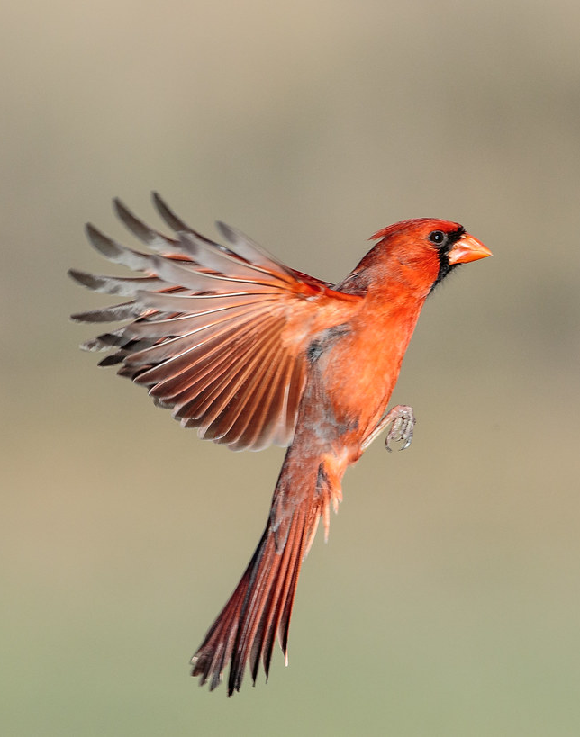

VCCS Cardinal Go-Live Payroll Meeting
September 30, 2022
This Photo by Unknown Author is licensed under CC BY

Slide 2
Payroll Transactions
  Agencies will continue to send all payroll documentation and calculation spreadsheets to SSC payroll.
  Direct deposit changes may now be entered by employees via Employee Self Service. New hire direct deposit information will continue to be retrieved via Avature and entered by payroll.
  Tax forms for new and existing employees will be retrieved via Avature and entered by payroll.
  Funding is now maintained on positions and no longer keyed by payroll.
  Refer to Financial communication for new process to generate out of state tax and nontax payment checks.
Notes:
Wendy (20 min – end by 11:25am)

Slide 3
Payroll – First Pay Runs Cardinal
BW3 Pay Period 9/9/2022 – 9/22/2022 Pay date 10/7/2022
  SPO Confirm Pay by noon on 10/5/2022
  SSC PR deadlines for additional transactions to be entered need to be submitted by Friday 9/30 at noon.
SM1 Pay Period 9/25/2022 – 10/9/2022 Pay date 10/14/2022
SM2 Pay Period 10/1/2022 – 10/15/2022 Pay date 10/14/2022
  SPO Confirm Pay by noon on 10/11/2022
  SSC PR deadlines for additional transactions to be entered need to be submitted by Friday 9/30 at noon.
Pay confirmations can only be approved by the agency Fiscal Officer or authorized proxies on file with SPO. This does not require logging into Cardinal to confirm pay. It requires signing and returning the Pay Confirmation Form and returning to SSC Payroll by 11:00 am on established deadline date.
Notes:
Wendy (20 min – end by 11:25am)

Slide 4
Payroll – VCCS HCM System Processes
Pay calendars will no longer be processed in VCCS HCM for timesheets or adjunct faculty payments. Approved wage hours will be transmitted via TA756 interface. Approved overtime hours for salaried non-exempt will be transmitted via TA756 interface.
Adjunct Faculty Pay needs to be entered in VCCS HCM Additional Pay page.
Supplemental Payments need to be entered in VCCS HCM Additional Pay page for both biweekly and semimonthly employees.
SSC will extract data, create the file, and will upload to Cardinal.
Error messages generated from the upload will be shared with each agency.
  *There will be a Q&A session at the end of the presentation to take a deep dive into this process*
Notes:
Wendy (20 min – end by 11:25am)

Slide 5
Payroll – Exceptions for Transfer of Hours to Cardinal
TA756 interface will not pick up any approved time for wage employees prior to 9/9/2022. This will require hours to be manually entered via SPOT for prior pay periods.
TA756 interface will not pick up any approved time for salaried non-exempt employees prior to 9/25/2022. This will require overtime hours to be manually entered via SPOT for pay period 9/10 - 9/24/2022.
Due to OT1 correction and timing of SQL application, an identified population of wage employees for pay period 8/26 – 9/8/2022 had records closed in error and will require payment by keying in SPOT. This has already been communicated to agencies who were impacted
Notes:
Wendy (20 min – end by 11:25am)

Slide 6
Payroll Deadlines
VCCS Cardinal Biweekly Pay Cycle ‐ Calendar Year 2022 (Hourly & Adjunct Faculty)
BW3 (Fri‐Thur) Pay Period Begin | BW3 (Fri‐Thur) Pay Period End | UPLOAD PY361 TEMPLATES FOR ADJ FACULTY - PY361 (Additional Pay) | HR Data Freeze 1 PM | All SPOT transactions entered and approved by Noon | Confirm Pay Noon Deadline (End HR Freeze) | Payday |  | H2R Deadlines for all updates needed for current pay period | PR Deadlines for all updates needed for current pay period
9/9/2022 | 9/22/2022 | 10/3/2022 | 10/3/2022 | 10/4/2022 | 10/5/2022 | 10/7/2022 |  | 9/30/2022 | 9/30/2022
9/23/2022 | 10/6/2022 | 10/6 - 10/7 | 10/14/2022 | 10/17/2022 | 10/18/2022 | 10/21/2022 |  | 10/5/2022 | 10/7/2022
10/7/2022 | 10/20/2022 | 10/19 - 10/21 | 10/28/2022 | 10/31/2022 | 11/1/2022 | 11/4/2022 |  | 10/19/2022 | 10/21/2022
10/21/2022 | 11/3/2022 | 11/2 - 11/4 | 11/11/2022 | 11/14/2022 | 11/15/2022 | 11/18/2022 |  | 11/2/2022 | 11/4/2022
11/4/2022 | 11/17/2022 | 11/16 - 11/18 | 11/25/2022 | 11/28/2022 | 11/29/2022 | 12/2/2022 |  | 11/16/2022 | 11/18/2022
11/18/2022 | 12/1/2022 | 11/30 - 12/2 | 12/9/2022 | 12/12/2022 | 12/13/2022 | 12/16/2022 |  | 11/30/2022 | 12/2/2022
12/2/2022 | 12/15/2022 | 12/14 - 12/16 | 12/23/2022 | 12/26/2022 | 12/27/2022 | 12/30/2022 |  | 12/14/2022 | 12/16/2022
12/16/2022 | 12/29/2022 | TBD - New Calendar Year Pending DOA Published Deadlines
 | All dates are subject to revision
Notes:
Wendy (20 min – end by 11:25am)

Slide 7
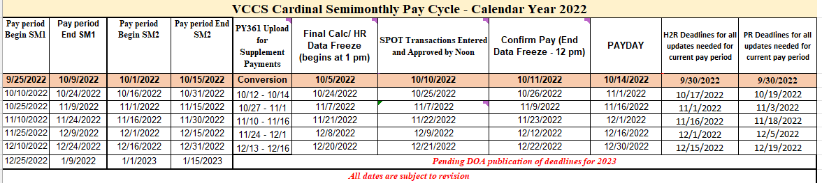
Payroll Deadlines
Notes:
Wendy (20 min – end by 11:25am)

Slide 8

Questions
Notes:
Lauren (15 min – end by 12:00pm)
Submit questions using link provided in Malinda’s email
Building FAQs

Slide 9

Support
  A Zoom room for support will be available the week of 10/3/22 from 8:30am To 5:00pm
  Join Zoom Meeting
    https://vccs.zoom.us/j/83216427786
      Meeting ID: 832 1642 7786
      +16469313860,,83216427786# US
  SSC Customer Engagement Team is also available help@ssc.vccs.edu
  We have also created a Cardinal page on the SSC website where you can find the Cardinal Business Impacts documents as well as recordings to this meeting and the deep dive meetings from Friday, 9/30/22 following those meetings.
  Please submit questions (https://bit.ly/Cardinal-Questions) to help us develop FAQs to be shared on the Cardinal page on the SSC site
  Expect the unexpected - Give Grace
Q&A Survey for future FAQs
Notes:
Stephanie (10 min – end by 11:45am)

