Slide 1
VCCS Shared Services Center
SSC Customer Engagement 877-340-5577
Help@ssc.vccs.edu
Procurement Spotlight Series Focus on…
Over-the-Counter (OTC) pCard Purchases

Slide 2
Content
Key Messages!
What’s new?
Disclaimers
The Change
The Steps … Slide 5
Make a List
Step 2. Check for Mandatory and Optional
Step 3. Micro or Small Vendor
Step 4. Tax Exempt Form
Step 5. Prohibited Items Check
Step 6. Forms, Forms, Forms

Slide 3
Key Messages!
pCards are a means of streamlining the VCCS procurement process
pCard use is encouraged by the Commonwealth.
However, pCards use must be compliant with Commonwealth procurement regulations. Non-compliant use puts you, your college, and the VCCS at risk.
As a pCard holder, it is your responsibility to understand these (extensive!) regulations
Failure to follow these regulations may mean you lose access to having a pCard
The SSC is here to help! You can reach out with questions at any time.
SSC Customer Engagement 877-340-5577
Help@ssc.vccs.edu

Slide 4
What’s new?
The Process for handling
Over-the-Counter (OTC)
pCard Purchases is Changing
The purpose of this training material is to:
Support our effort eliminate the need to complete confirming orders in eVA after making pcard over-the-counter (OTC) purchases.
Highlight the procurement laws, policies and rules that govern the over-the-counter (OTC) purchases that you will make with your pcard.

Slide 5
Disclaimers…
 | pCard is a payment tool (not a procurement method)
 | pCard end users SHALL follow Procurement and A/P regulations
pCard end users are responsible for ensuring procurement compliance
pCard end users are responsible for ensuring CAPP p-Card compliance
This training …
… does not replace end-user pCard training
… will focus on the CHANGE to the process
… does include the important procurement rules for these small pCard purchases

Slide 6
The Change
Over-the-Counter (OTC) pCard purchases (as defined by the APSPM) are NOT required to be entered into eVA. Cardholders may purchase over-the-counter without eVA entry up to the current small purchase threshold.
Definition:
“Over the counter small purchase charge card (SPCC) purchases that are made at the site of the sale and picked up by the individual card holder.”
APSPM (14.9.e.1)
Revised Business Rule:
“End-users must initiate each transaction via PO or voucher request … and Point of Sales / Over the Counter small purchase charge card (SPCC) purchases that are made at the site of the sale and picked up by the individual card holder are exempt from eVA Entry (per APSPM 14.9.e.1)”

Slide 7
The High-Level Procurement Steps
1 | Make a List | Compile a list of the items / services needed to purchase over-the-counter
2 | Check for Mandatory and Optional | Ensure the items / services are NOT provided by a mandatory source, contract, or optional state contract. (APSPM Chapter 2)
3 | Micro or Small Vendor | Ensure the vendor IS a Micro or Small (SWAM certified at minimum) or additional forms may be necessary (APSPM Chapters 3,4,5)
4 | Tax Exempt Form | Ensure you have a completed Tax Exemption Form in hand and provide a copy to vendor. (APSPM 3.24)
5 | Prohibited Items Check | Ensure NONE of the items planned to purchase over-the-counter are on the prohibited list.
6 | Forms, Forms, Forms | Ensure all necessary documents have been obtained and you know what is to be done with them (Business Meal Forms, Written Determinations, Waivers, etc)
Back to Slide 1

Slide 8
Where do I go from here?
Path 1: I need a refresher on the Procurement Rules
Path 2: What do I do with all my forms?
What procurement rules? There are procurement rules I have to follow for over-the-counter purchases:
Continue through the detailed slides starting on Step 2.
You already know all the detailed procurement rules and just need to know how to attach and retain the forms:
Go Directly to Step 5, slide 35 through Step 6 to Complete this training.
Step 2. Check for Mandatory and Optional
Step 3. Micro or Small Vendor
Step 4. Tax Exempt Form
Step 5. Prohibited Items Check
Step 5. Prohibited Items Check, Business Meal Exception, Slide 35

Slide 9
Step 2. Check for Mandatory and Optional
OTC pCard Steps
Ensure the items / services are NOT provided by a mandatory source, contract, or optional state contract. (APSPM Chapter 2)
Back to Slide 1

Slide 10
Step 2. Check for Mandatory and Optional
2 | Check for Mandatory and Optional | Ensure the items / services are NOT provided by a mandatory source, contract, or optional state contract. (APSPM Chapter 2)
There are THREE types of Mandatory / Optional Contracts that need to be considered in Step 2…
Mandatory Sources Mandatory Sources are other state agencies with whom we SHALL (must) purchase from when procuring certain goods and services.
Mandatory Contracts Mandatory Contracts are “term” contracts that the Commonwealth (DGS/DPS) has entered into with a variety of vendors that we must use.
Optional Contracts Optional Contracts are other “term” contracts that DGS/DPS has established with potential vendors that we MAY use.
1
2
3
Waiver Required
Waiver Required
Justification Required
Please note: There are many contract options available. Please check the eVA State Contracts list.

Slide 11
Mandatory Sources
Mandatory Sources are other state agencies with whom we SHALL (must) purchase from when procuring certain goods and services.
Challenge: The items “offered” by Mandatory Source vendors changes over time – YOU need to check against the supplier’s catalog.
Waiver: The Mandatory Source MAY approve a waiver if the College has a good justification (waiver form required).
Summary: IF the item is offered by a Mandatory Source and a waiver is NOT granted, then an OTC pCard purchase for the item is NOT compliant.

Slide 12
Mandatory Sources
Mandatory Source | General Description of Goods and Services
Virginia Correctional Enterprises (VCE) | Provides printing services, safety supplied & equipment, janitorial cleaning supplies, signage, calendars, planners, apparel, remanufactured ink/toner, furniture, standing desks, etc.
Department for the Blind and Vision Impaired (DBVI) | Provides writing instruments, spices, vending and café services, safety supplies, mops, buckets, safety vests and gloves
Virginia Distribution Center (VDC) | Provides dry goods (paper towels, cups, plates, napkins, etc), dry & frozen foods, baking goods and supplies, bottled water, cleaning supplies, batteries, first aid kits, ice melt, paint, flags, coffee & tea
Office of Graphics (OGC) | Provides designing and creation services for requirements over $750.00
Fleet Management (Fleet) | Provides and manages fleet vehicles, car rentals, including contracts for agencies to use to purchase agency owned vehicles
Virginia Information Technology Agency (VITA) | Provides information technology services. Although considered a “mandatory” source”, VCCS authority allows us to treat VITA as an optional source.

Slide 13
Mandatory State (term) Contracts
Mandatory State Contracts “To obtain more favorable prices through volume purchasing and to reduce lead-time and administrative cost and effort, DGS/DPS may establish mandatory use term contracts for goods or services. DPS contracts are posted on the eVA State Contracts listing. Agencies and institutions are required to check this listing for contracts, contract changes, renewals, and mandatory use prior to placing orders.” APSPM
Challenge: It can be difficult navigating the available Mandatory State (term) contracts.
Summary: The list of Mandatory State Contracts is extensive. Please visit eVA and check to see if the item is available via a Mandatory State Contract. A waiver may be granted if justification is approved.

Slide 14
Example Mandatory State Contracts
Example Goods and Services | Contracted Options
Palletized Paper | BW Wilson
Car Rentals | Enterprise
Bulk Fuels | Vendors by Territory
Gases | Vendors by territory
Mailroom Equip | Pitney Bowes, Quadient Inc, DMT Solutions Global
Ice Machines | Crystal Ice
Plain envelopes | TSRC or BW Wilson
AEDs | Vendors by territory
ETC
Please note: There are many Mandatory State contracts. Please check the eVA State Contracts list.

Slide 15
“Optional” State Contracts
“Optional” State Contracts are “strongly encouraged” by the Commonwealth of Virginia – YOU must justify not using.
Challenge: “Optional State Contracts” MUST be considered first, before alternative options.
Justification: A written justification MUST be included if you need to select an alternative option. Submit with your Log and keep the justification on file.
Summary: Optional State Contracts can be bypassed IF a written justification is included with the procurement.

Slide 16
“Optional” State Contracts
Optional Contract Goods and Services | General Description
Office Supplies | Vendors by territory
Clothing & Footwear | Multiple vendors
Document Shredding | Iron Mountain, Commonwealth Doc Management
Graduation Photography | Photo Specialties Inc.
Automotive parts | NAPA, Parts Authority LLC, AutoZone Parts Inc
Science Laboratory Supplies and equipment | Multiple vendors
Medical Supplies
ETC
Please note: There are many “Optional” state contracts. Please check the eVA State Contracts list.

Slide 17
Warning
Please note: There could be severe consequences for the VCCS (All Colleges, SO, SSC) if it is deemed, we are intentionally ignoring the Code of Virginia.
Please check for Mandatory and Optional state contracts before proceeding with your pCard purchase.
APSPM 2.1.a
“The purchase by agency personnel of goods or services that are on DGS/DPS mandatory contracts from non-contract sources may result in reduction or withdrawal of that agency’s delegated purchasing authority by DGS/DPS”

Slide 18
Step 3. Micro or Small Vendor
OTC pCard Steps
Ensure the vendor IS a Micro or Small (SWAM certified at minimum) or additional forms may be necessary (APSPM Chapters 3,4,5)
Back to Slide 1

Slide 19
Step 3. Micro or Small Vendor
3 | Micro or Small Vendor | Ensure the vendor IS a Micro or Small (SWAM certified at minimum) or additional forms may be necessary (APSPM Chapters 3,4,5)
If the remaining items on your list are:
Then the next step is to work through the SWaM requirements…
NOT supplied by a mandatory source, mandatory contract, optional contract OR,
You have received an approved waiver (for Mandatory) / draft a justification (for Optional Contracts)
SWaM
The Commonwealth of Virginia SWaM Procurement Initiative was established to enhance business opportunities for small, women- and minority-owned businesses and to ensure a level playing field for all small businesses in the Commonwealth of Virginia.
SWaM is the acronym for Small, Women- and Minority-owned businesses.
A SWaM vendor is a business that has been certified by the Virginia Department of Small Business and Supplier Diversity and is listed in the SWaM Vendor Directory.

Slide 20
Micro or Small Vendor
Assumption: Your purchase will be less than $10,000 (i.e. a “Single Quote Small Purchase”)
Requirement: You SHALL (must) purchase from a:
(1) Micro Vendor (2) Small Vendor (3) Other SWaM Vendor (in priority order)
IF the price is fair and reasonable (within 5% of a non-SWAM)
Justification: If a “fair and reasonable” SWaM option is not available, you will need to complete a “price reasonableness” form, submit with log and keep on file.
Summary: Meeting the Commonwealth SWaM targets is an important, collaborative effort.

Slide 21
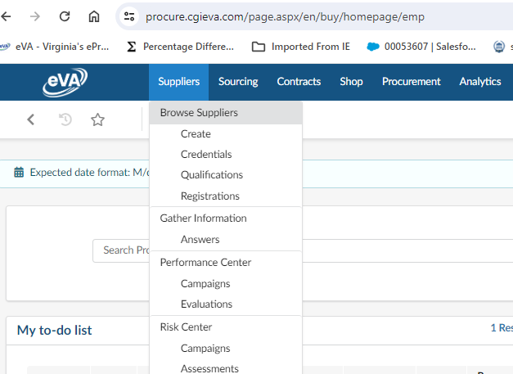
Locating Suppliers in eVA
1
Select “Browse Suppliers” from the “Suppliers” pull down menu
1

Slide 22
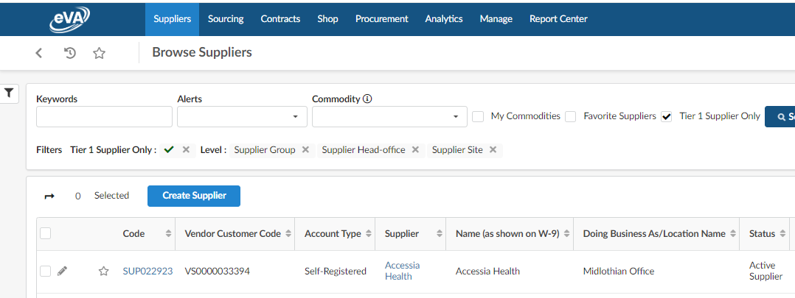
Locating Suppliers in eVA (cont’d)
2
Open the “filter” option on the Suppliers page
2

Slide 23
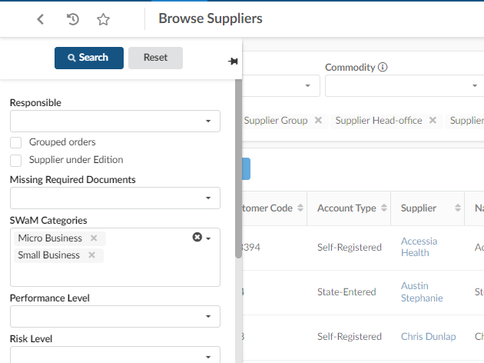
Locating Suppliers in eVA (cont’d)
3
From the “filter” window, navigate to the “SWaM Categories” and select “Micro Business” and “Small Business”
3

Slide 24
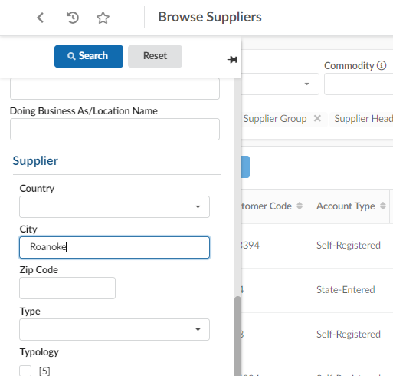
Locating Suppliers in eVA (cont’d)
5
4
Additional Search Option: If you scroll down, you may enter additional filter options. City or zip code may be helpful to enter.
5
Select “Search” after entering your search options.
4

Slide 25
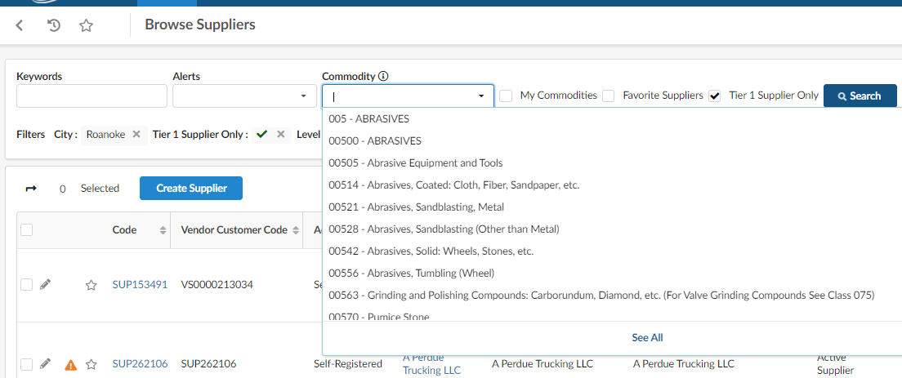
Locating Suppliers in eVA (cont’d)
6
After applying your filter, you may want to add a Commodity filter to help narrow the list.
6

Slide 26
Step 4. Tax Exempt Form
OTC pCard Steps
Ensure you have a completed Tax Exemption Form in hand and provide a copy to vendor. (APSPM 3.24)
Back to Slide 1

Slide 27
Step 4. Tax Exempt Form
4 | Tax Exempt Form | Ensure you have a completed Tax Exemption Form in hand and provide a copy to vendor. (APSPM 3.24)
State Sales
“The Commonwealth of Virginia is generally exempt from paying Virginia's sales taxes on purchases of tangible personal property for its use or consumption.”
Excise Tax
“The Commonwealth of Virginia is generally exempt from paying federal excise taxes, except it must pay excise taxes for air transportation, the cost of which is generally defined as any amount paid within the United States for transportation of any person by air.”
APSPM 3.24
Tax Exemption Certificate (Form ST 12, see Annex 3-F)”
Please note: If you do pay state sales tax on your over-the-counter purchase in error, then you will need to contact the vendor, provide the exemption form and request a reverse and credit of the state sales tax charges. You must post the credit to the same card used to make the purchase.
References: APSPM 3.24, CAPP Tax Bulletin 16-3

Slide 28
Step 5. Prohibited Items Check
OTC pCard Steps
Ensure NONE of the items planned to purchase over-the-counter are on the prohibited list.
Order Splitting
Gift Card Purchases
Conflicts of Interest
Improper Expenses
Business Meal Requirements
Back to Slide 1

Slide 29
Step 5. Prohibited Items Check
5 | Prohibited Items Check | Ensure NONE of the items planned to purchase over-the-counter are on the prohibited list.
Please note: There are some restrictions on what can be purchased with a pCard. Although not an exhaustive list, the following restrictions will be discussed:
Order Splitting
Gift Card Purchases
Conflicts of Interest
Improper Expenses
Business Meal Requirements

Slide 30
Step 5. Prohibited Items Check (cont’d) -- 1. Order Splitting --
“Order Splitting” is when a user intentionally places multiple orders for the same good or service in order to avoid following procurement law… and it is prohibited
Order Splitting is Prohibited
“The placement of multiple orders [purchases] within other than a reasonable time period to one or more vendors for the same, like, or related goods or services to avoid using the appropriate method of procurement or to remain within delegated purchasing authority is prohibited. Order splitting results in higher administrative cost to the agency. It is a highly inefficient practice.”
APSPM 4.11

Slide 31
Step 5. Prohibited Items Check (cont’d) -- 2. Gift Card Purchases --
There are only two instances when you can use a pCard to purchase gift cards:
Employee Recognition | See DHRM Policy 1.15 and ensure that you are following CAPP 20355 logging and tracking requirements
DOA Exception | If you have an exception granted by the Department of Accounts (DOA), then you must include appropriate documentation in your file. Federal funded gift cards for students such as gas cards must follow all procurement rules and may be purchased using your pCard, if the purchase is under the single quote threshold without order splitting. If you are purchasing gift cards for students, you shall log and track those cards in accordance with IRS https://www.irs.gov/forms-pubs/about-form-1099-misc.
References: DHRM Policy 1.15, CAPP CAPP 20355

Slide 32
Step 5. Prohibited Items Check (cont’d) -- 3. Conflicts of Interest --
pCard Purchases are subject to the same Conflict of Interest regulations as any other procurement. See Article 6
(Ethics are moral principles that govern a person’s behavior or the conducting of an activity)
Article 6
Ethics in Public Procurement
§ 2.2-4367. Purpose.
“The provisions of this article supplement, but shall not supersede, other provisions of law including, but not limited to the State and Local Government Conflict of Interest Act, the Virginia Governmental Frauds Act, and Articles 2 and 3 of Chapter 10 of Title 18.2.
The Provisions of this article shall apply notwithstanding the fact that the conduct described may not constitute a violation of the State and Local Government Conflicts of Interest.”

Slide 33
Step 5. Prohibited Items Check (cont’d) -- 3. Conflicts of Interest (cont’d) --
Conflicts of Interest Act (§ 2.2-3106) “No officer or employee of any governmental agency of state government or Eastern Virginia Medical School shall have a personal interest in a contract with the governmental agency of which he is an officer or employee, other than his own contract of employment.”
Immediate Family
Spouse and anyone who both lives in your home and is a dependent of you
Personal Interest
A financial benefit or liability accruing to an employee or a member of the employee’s immediate family
Prohibited Conduct
Do not accept money, job offer, etc. to act in someone’s favor
Do not use confidential information to better your own position
Do not use you position to get someone a job or contract

Slide 34
Step 5. Prohibited Items Check (cont’d) -- 3. Conflicts of Interest (cont’d) --
Employee | cannot also be a vendor must disclose other employment cannot accept honoraria for expertise or opinions related to their official duties
Procurement | When employees have an immediate family member or personal interest in a vendor of a procurement transaction, then they must excuse themselves from participation
Prohibited | Gifts from vendors over a nominal amount of $20 is prohibited Kickbacks of any kind are prohibited
Code References:
§ 2.2-3103
§ 2.2-3106
§ 2.2-3112
§ 2.2-4368-
§ 2.2-4373
§ 2.2-4376-
§ 2.2-4377

Slide 35
Step 5. Prohibited Items Check (cont’d) -- 4. Improper Expenses --
Improper Expenses
The following are considered improper expenses -- you are prohibited from using state funds (and in some cases any government funds) to procure these goods (CAPP 20310):
No personal expenses (meals, travel, lodging, etc. and more listed below) Please note: transactions are audited for hotel payments made on-site for validity
Snacks or refreshments
Baby sitting
Non-business-related newspapers or magazine subscriptions
Personal articles that are lost or stolen
Tuxedos or other formal wear
Clothing (non-uniform) or repairs to clothing damaged in the workplace
All expenses related to personal negligence of the employee, such as traffic fines
Expenses that do not support the agency mission (e.g. Alcoholic beverages, Charitable contributions, Holiday decorations, Gifts and flowers)
Mobile Wallet apps are not allowable: Library of Virginia GS-102.

Slide 36
Step 5. Prohibited Items Check (cont’d) -- 5. Business Meal Requirements --
Business Meals
Business Meals shall NOT be treated as over-the-counter purchases
VCCS Governance has determined that business meals (even if purchased in an over-the-counter manner) will continue to required eVA entry through a requisition ahead of the purchase or if necessary, a confirming order after the meal is taken
A fully signed Business Meal Food Form will be required to be attached to the eVA requisition
You can find the Business Meal Approval Request Form on the SSC Website, Forms
eVA will remain the system of record for these purchases

Slide 37
Step 6. Forms, Forms, Forms
OTC pCard Steps
Ensure all necessary documents have been obtained and you know what is to be done with them (Business Meal Forms, Written Determinations, Waivers, etc)
Back to Slide 1

Slide 38
Step 6. Forms, Forms, Forms
6 | Forms, Forms, Forms | Ensure all necessary documents have been obtained and you know what is to be done with them (Business Meal Forms, Written Determinations, Waivers, etc)
It is extremely important that the VCCS maintain the appropriate documentation that has been discussed throughout this training, including:
Written Justifications
Waivers
Price Reasonableness
DOA Exceptions
Business Meal Forms

Slide 39
Step 6. Forms, Forms, Forms (cont’d)
6 | Forms, Forms, Forms | Ensure all necessary documents have been obtained and you know what is to be done with them (Business Meal Forms, Written Determinations, Waivers, etc)
Complete the appropriate documents and then attach them to your reconciliation log as follows:
Reconciliation Process | How to attach the document
Colleges using Online Reconciliation through BOA Works | Upload the document(s) in BOA Works to the specific associated transaction
Colleges using the Legacy Excel Reconciliation Logs (Entitled by DOA in the CAPP Manual as “Cardholders Reconciliation Log”) | Include all documents associated with the transactions in the period to the file upload for the period

Slide 40
Step 6. Forms, Forms, Forms (cont’d)
6 | Forms, Forms, Forms | Ensure all necessary documents have been obtained and you know what is to be done with them (Business Meal Forms, Written Determinations, Waivers, etc)
Contract Numbers
Please note:
If your purchase was completed at the storefront and the item(s) or services were bought under contract, then you will need to notate the contract number on your reconciliation log.
SSC Buyers will no longer be able to add the contract numbers.
The VCCS is required to track all contract spend (DGS, APA)

Slide 41
Step 6. Forms, Forms, Forms (cont’d)
6 | Forms, Forms, Forms | Ensure all necessary documents have been obtained and you know what is to be done with them (Business Meal Forms, Written Determinations, Waivers, etc)
Records Retention
Procurement document retention policy states all procurement documents shall be retained for a period of 5 years after the last transaction.
CAPP 20310 requires copies of Cash and Bank Records, including reconciliations, to be retained for 3 years.
After you have uploaded your documents to your reconciliation log, you will need to save your document in a safe and secure repository
The documents shall be stored in a place that is accessible by others, in case you are unavailable at the time the document is requested
The documents shall be named in such a way that they are easily found by someone that needs to locate them.
Recommendation: Date, Vendor, Brief Description (e.g. 231108, Airgas, Acetylene Refill)

Slide 42
Step 6. Forms, Forms, Forms (cont’d)
6 | Forms, Forms, Forms | Ensure all necessary documents have been obtained and you know what is to be done with them (Business Meal Forms, Written Determinations, Waivers, etc)
Freedom of Information Act (FOIA)
All purchases are subject to the Freedom of Information Act (VPPA 2.2-4342F)
Be prepared at any time to access your purchase transaction documents, including your log and submit them to the College FOIA Officer
If the SSC FOIA Officer receives a request for your records, then your College FOIA Officer will be notified, and you will need to provide the information as requested.

Slide 43
SSC Customer Engagement 877-340-5577
Help@ssc.vccs.edu

