Slide 1

VCCS
Shared Services Center
Procure
to Pay Spotlight Series
Focus on…
Create a Punchout or Catalog Requisition
SSC Customer Engagement
877-340-5577
Help@ssc.vccs.edu

Slide 2
Create a Punchout or Catalog Requisition
In this training, we will learn how to create a Catalog or Punchout Requisition. We will create:
Section A: Punchout Catalog Shopping (including edits)
Section B: Complete the Requisition in eVA
Section C: Catalog Item Requisition
Definitions:
Punchout Requisition | A requisition that is created from a supplier-maintained website
Catalog Requisition | A requisition that is created from a ‘built-in’ vendor catalog within eVA
Please note: Catalog or Punchout items that populate a requisition do not require an additional quote from the vendor.

Slide 3
Section A
Punchout Catalog Shopping (including edits)

Slide 4

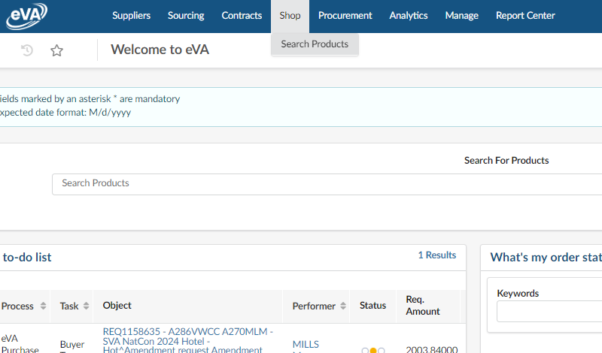

Create a Punchout or Catalog Requisition
Let’s begin learning how to create a punchout requisition by walking through the following steps:
1. Select the Shop tab.
2. Select the Search Products option from the dropdown menu.

Slide 5
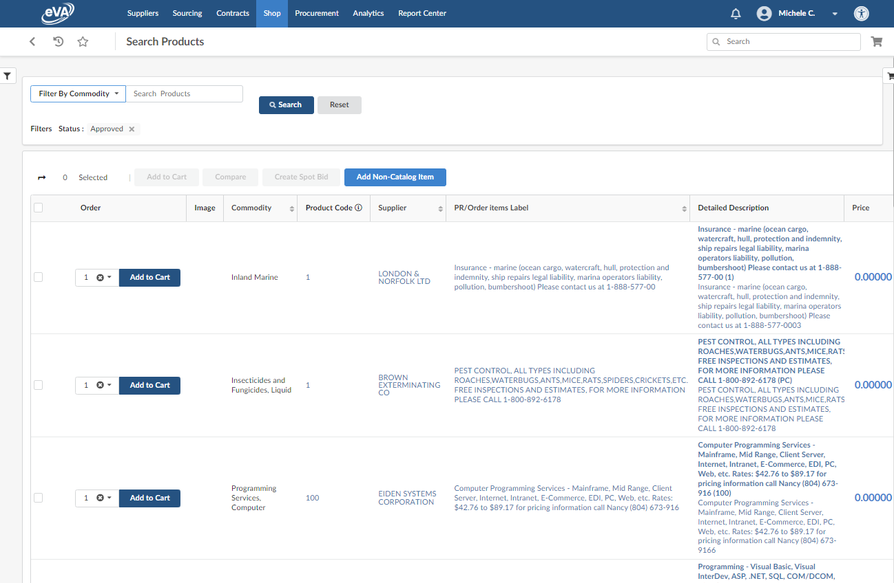
Create a Punchout or Catalog Requisition
On this Catalog page you will notice:
Thousands of results will be displayed
There are eVA catalog items and links to suppliers punchout catalogs.
Many filter options are there to help

Slide 6
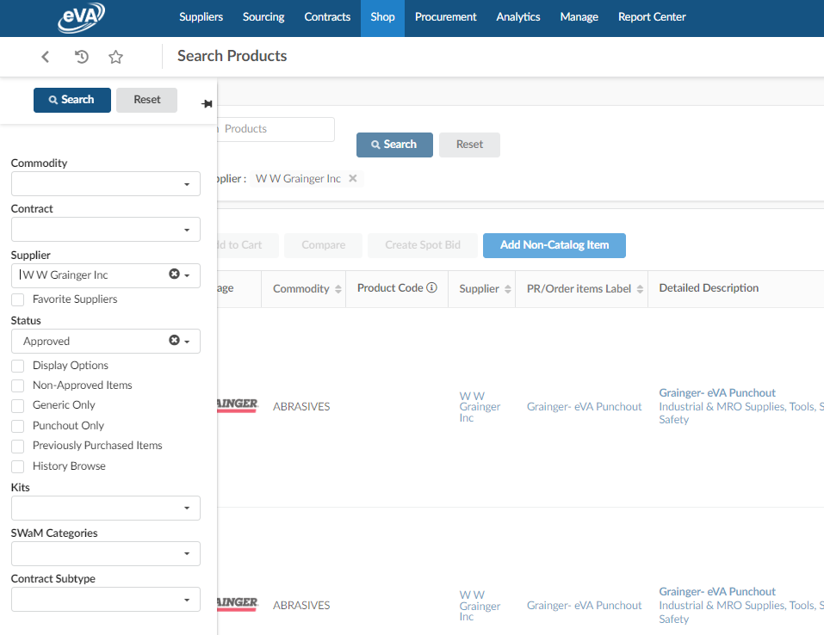

Create a Punchout or Catalog Requisition
For our example, let’s say we want to create a requisition for ‘Air Filters’ from Grainger. To do that let’s begin with:
In the filter options, search and select the supplier W W Grainger Inc
Press Search
Please Note: If the filter options are not displayed click the filter symbol located at the top left of the search products page.

Slide 7
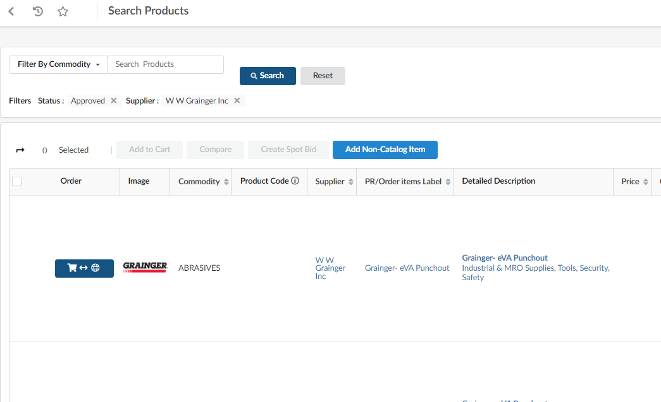

Create a Punchout or Catalog Requisition
Results from our filtered search will display.
Click the ‘cart to website’ icon. This will take you to the suppliers punchout catalog.
Helpful Hint: Punchout Catalogs display a ‘cart to website’ icon next to the supplier's name.

Slide 8
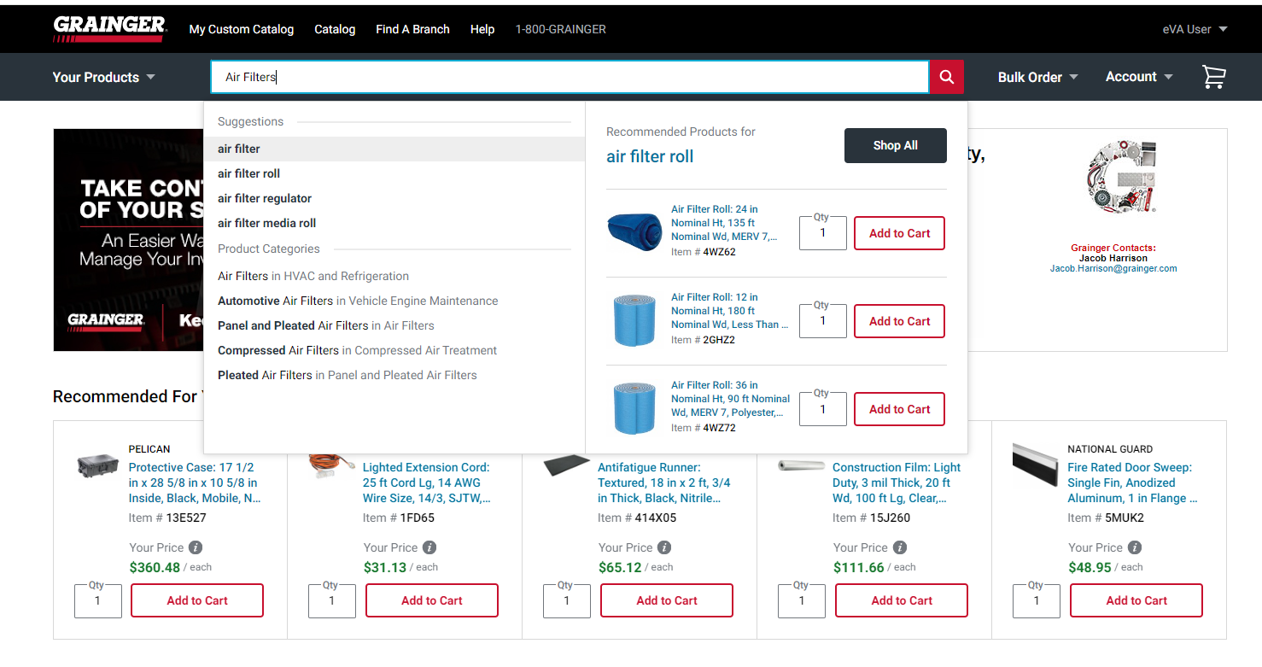
Create a Punchout or Catalog Requisition
Now we are in the supplier’s website and in this example: Grainger. Time to find our Air Filters.
Type ‘Air Filters’ in the Search area and click the search icon

Slide 9
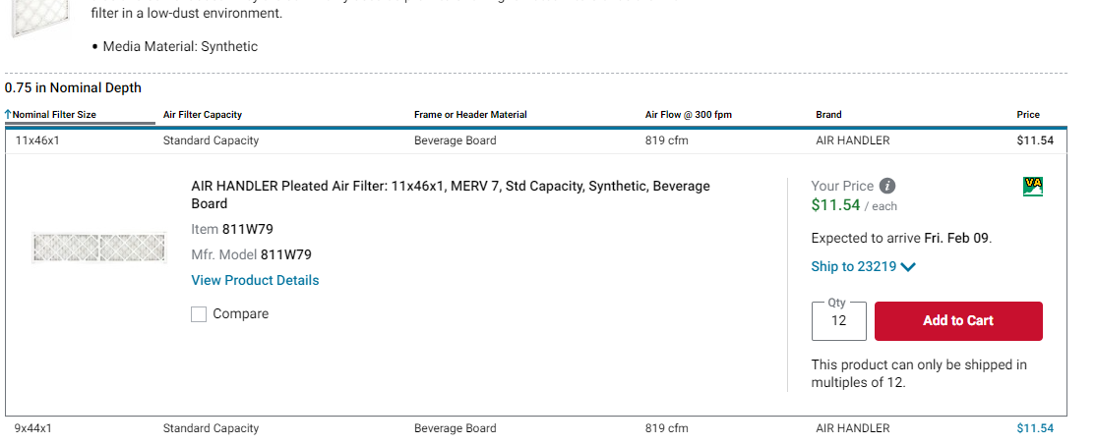
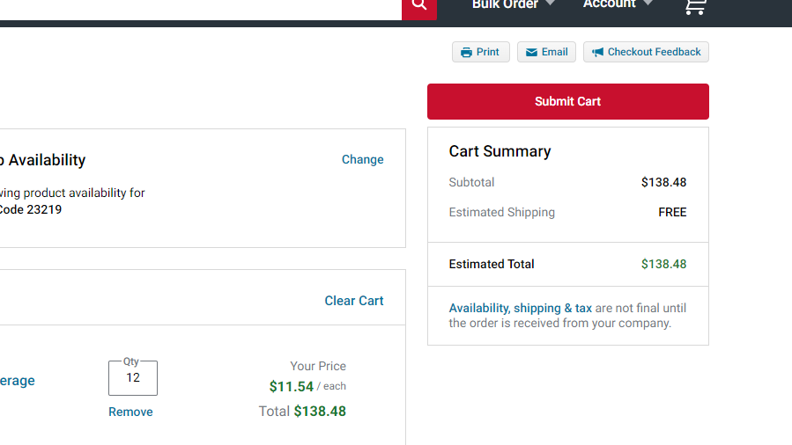
Create a Punchout or Catalog Requisition
Add the desired items to the shopping cart by entering your quantity and clicking the Add to Cart button.
Locate your shopping cart and Submit Cart.
Please Note: As with any online shopping experience, each supplier's catalog view and steps may differ slightly. The goal is to complete shopping in the vendors catalog and submit the order to pull the items out to the eVA shopping cart.

Slide 10
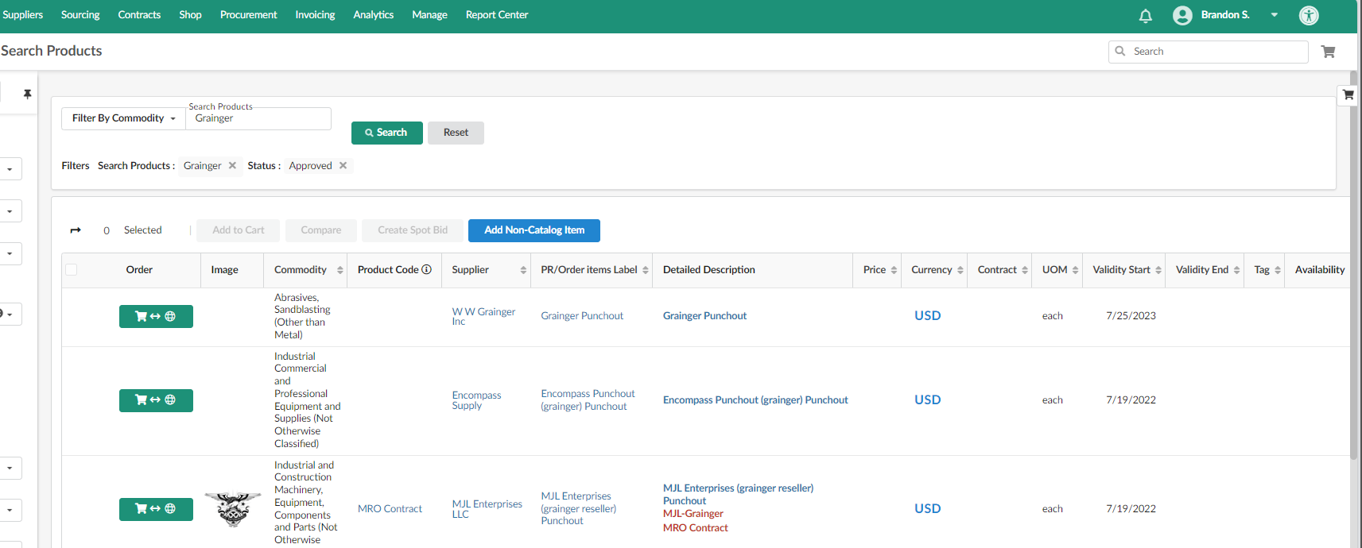

Create a Punchout or Catalog Requisition
After clicking the submit to cart button on the supplier’s website, you will automatically be taken back into the eVA catalog screen. The items you added from the punch-out catalog are now in an eVA shopping cart.
3. Click the black shopping cart icon to expand a side panel.

Slide 11

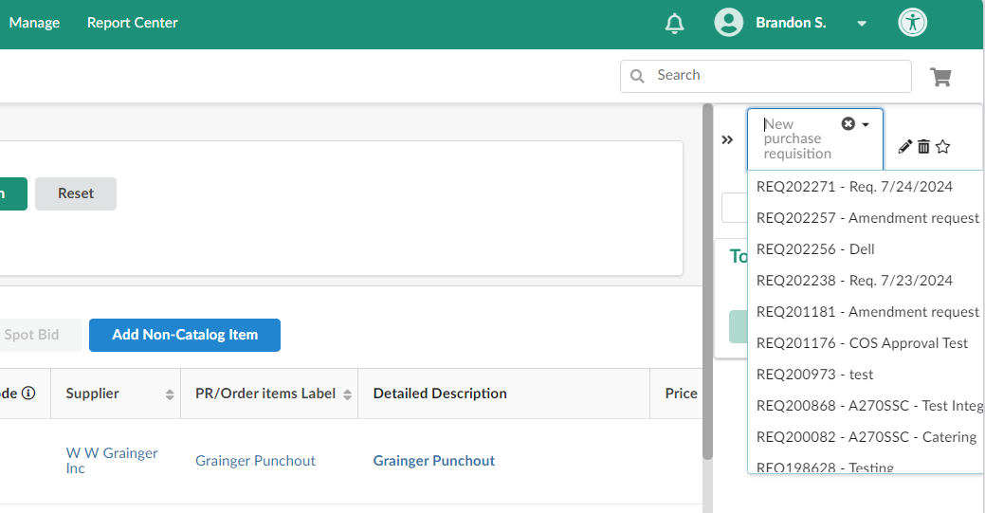


Create a Punchout or Catalog Requisition
In the expanded cart side panel, click the drop-down arrow next to New purchase requisition. eVA has populated your items into a requisition draft which will be the first option at the top of the list with the current date. You will also see all of your other draft requisitions as well.
Select the top requisition in the list

Slide 12
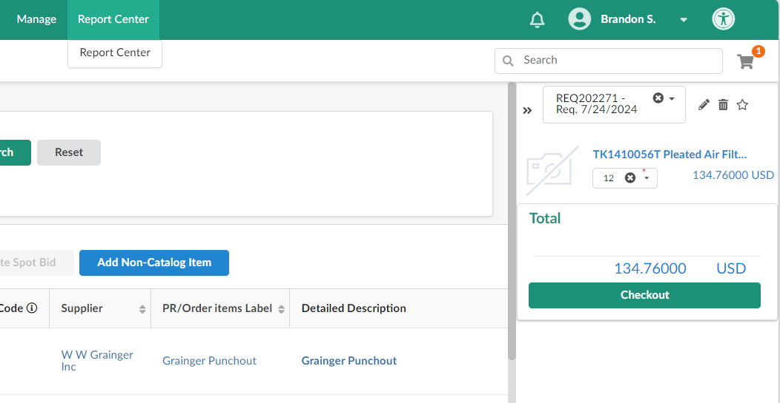

Create a Punchout or Catalog Requisition
The items from the punch-out will now be shown in the eVA shopping cart.
Confirm the items are correct and click Checkout. This will pull your items into the matching eVA requisition number shown at the top.

Slide 13
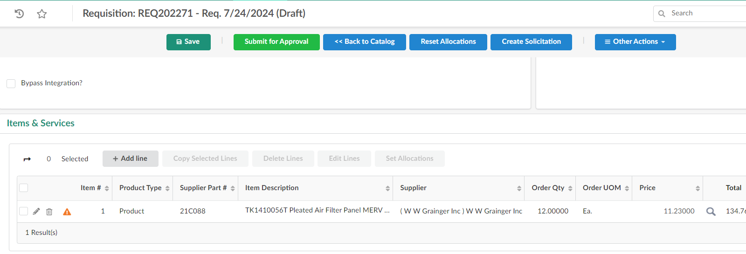
Create a Punchout or Catalog Requisition
The requisition is displayed with your punch-out items (below). To continue to populate the requisition details if you’re finished shopping the vendor's catalog skip to Section B slide 19.
We will continue in the following slides to learn how to add additional items.

Slide 14
Create a Punchout or Catalog Requisition
To add additional punch-out items to your requisition, click the “<<Back to Catalog” button. This will return you to the eVA shopping / catalog section.
Please Note: This option is only available while the requisition is in draft status. If your requisition is already submitted into workflow, you can withdraw it to return to draft.
Caution: Returning to the catalog is only to add additional items not already on the requisition. To adjust quantity or delete a line use the pencil or trash can icons on the requisition line.

Slide 15
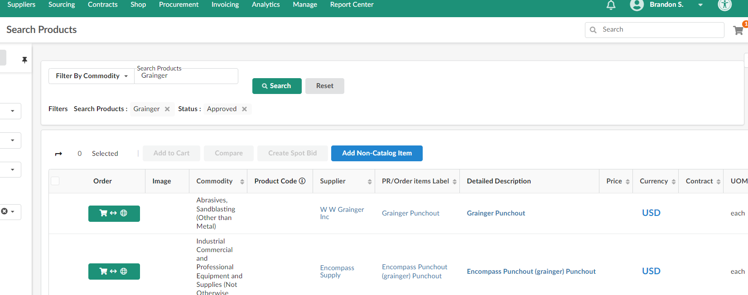
Create a Punchout or Catalog Requisition
Now we have returned to the eVA shopping catalog screen.
Click the cart to web icon to re-access vendor’s punchout catalog.

Slide 16
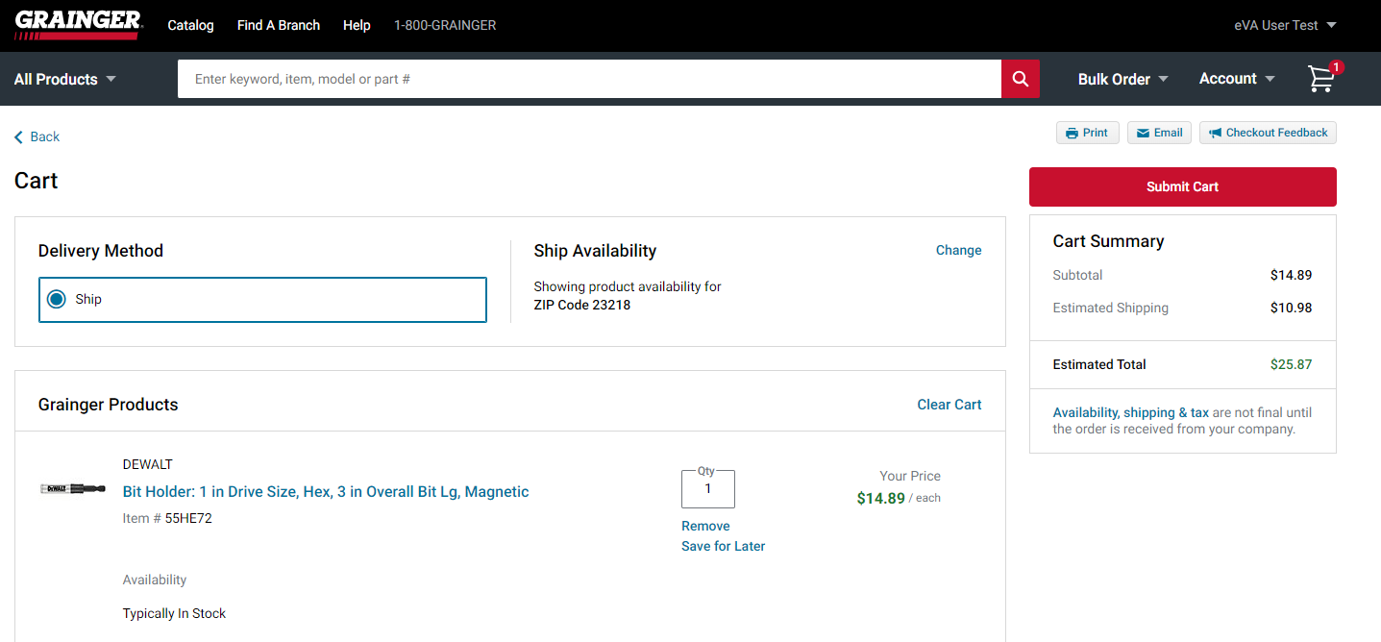
Create a Punchout or Catalog Requisition
Add additional items and submit cart.
Reminder: This is a new cart. You will not see your previously added items; however, the new items will be added to your original requisition.

Slide 17
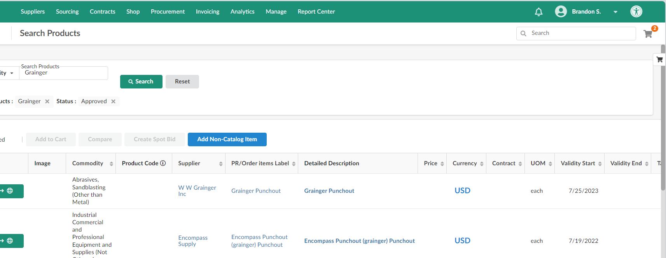


Create a Punchout or Catalog Requisition
You were returned to the search products / eVA catalog page.
Click the gray shopping cart and note that it now shows your updated line items total. This will return you to the requisition with your original and newly added items.

Slide 18
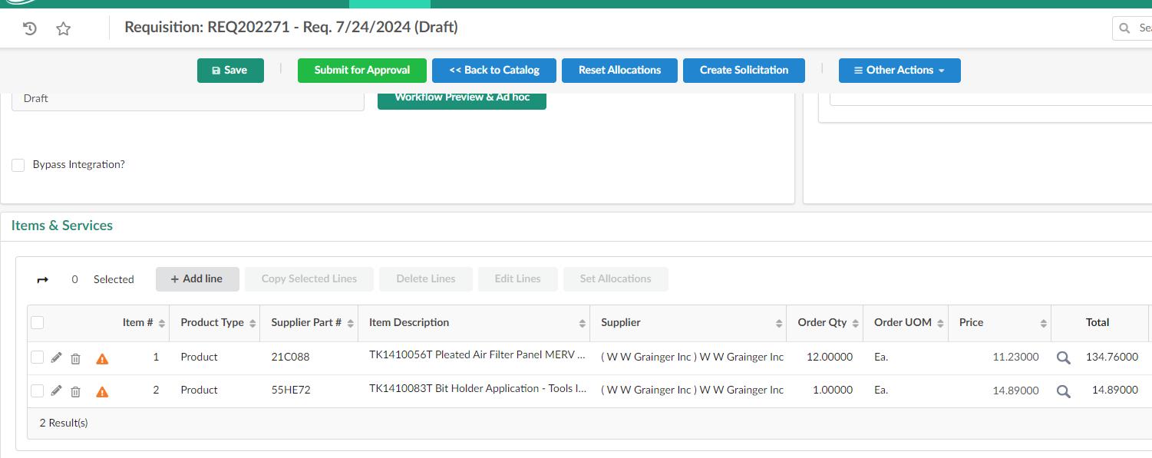

Create a Punchout or Catalog Requisition
You are now returned to your requisition with your original items and newly added items. Continue to step B to populate requisition details and submit for approval.
Submit punchout requisitions as soon as possible after creating them as price changes in catalogs are very frequent and prices will not update on the lines already extracted to a requisition.

Slide 19
Section B
Complete the Requisition in eVA

Slide 20
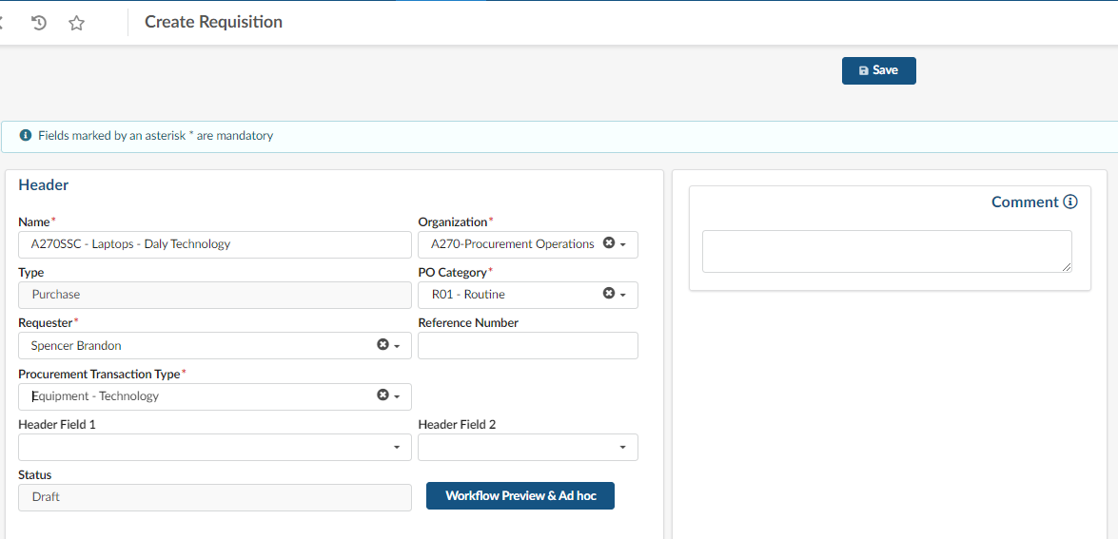
Create a Punchout or Catalog Requisition
Now, let’s complete your requisition starting with the header in the steps below:
 | Field | Instruction | Helpful Hint
1 | Name | Fill in your College Acronym as well as a description of your purchase | Your College Acronym is your Agency Number followed by your College abbreviation (ie A295TCC)
2 | PO Category | Fill in R01 – Routine Category | Most punchout catalog requisitions are routine purchases
3 | Procurement Transaction Type | Select from equipment or supplies | Generally punchout catalog purchases are one of these two options
4 | Save | Click Save to complete the Requisition Header | Once you click save your allocations will made visible
Do not change organization. This is defaulted to the requesters assigned organization.

Slide 21
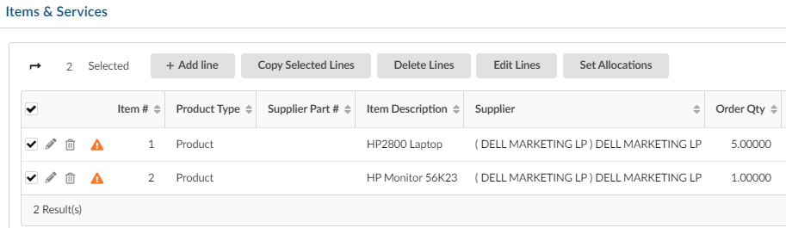
Create a Punchout or Catalog Requisition
Next, we need to select the accounting budgets to use for this requisition by following 5 steps:
Step | Instruction
1 | Select the lines you would like to set allocations for by using the checkboxes
2 | Click the Set Allocations button

Slide 22
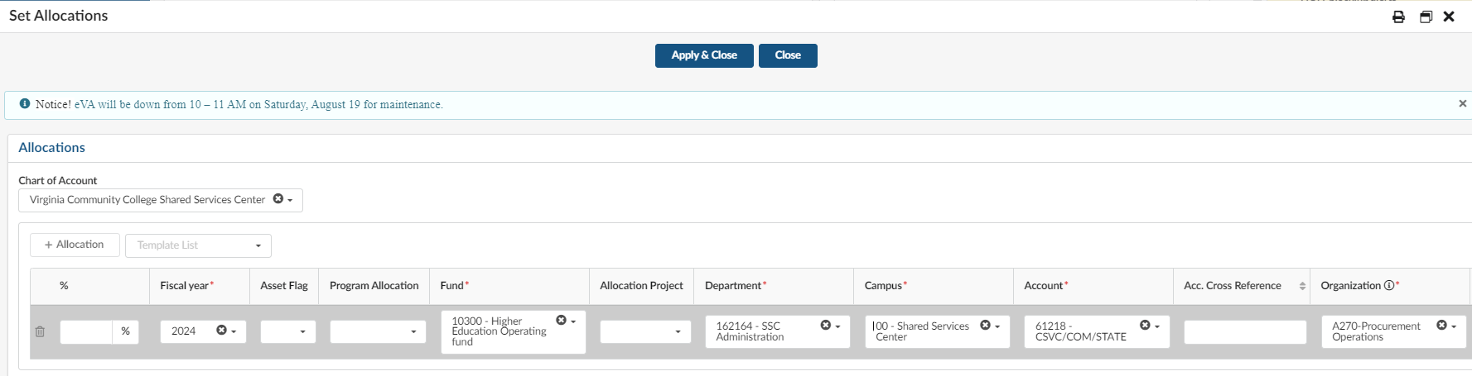
Create a Punchout or Catalog Requisition
Step | Instruction
3 | Click the +Allocation button to show the fields for entry
4 | Fill out the required fields indicated by an asterisk (*)
5 | Click Apply & Close to set the allocations for the lines & return to the header view
If you need assistance with your budget codes, please contact the Business Manager at your College
Do not change organization. This is defaulted to the requesters assigned organization.

Slide 23

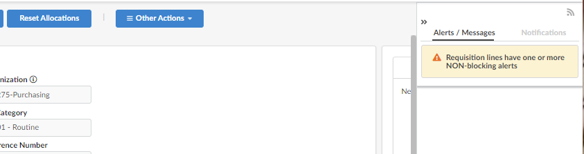
Create a Punchout or Catalog Requisition
The last section to complete before we submit our requisition is to communicate any messages or attachments to the buyers using the following steps:
Step | Instruction
1 | Locate the Alerts/Messages (‘Blog’) section on the far right
Note | If you cannot see the tool, click the alert icon in the upper right
Please note: While there are other areas of the requisition to add comments or attachments, the Alerts/Messages Tool is the chosen method that our VCCS Agency has chosen to standardize as our process

Slide 24


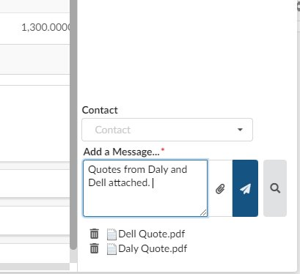
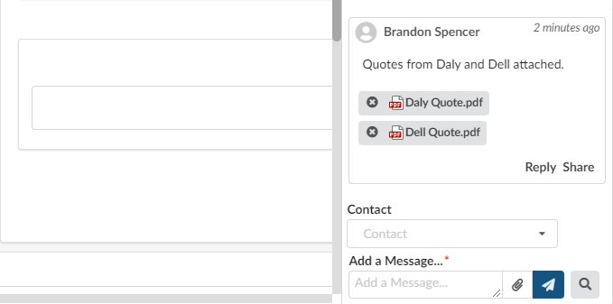
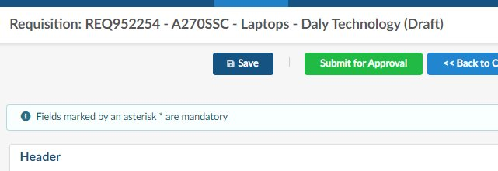
Create a Punchout or Catalog Requisition
Step | Instruction
2 | Type your communication in the Add a Message section
3 | If you have an attachment, click the paperclip icon and choose your files to upload. You will notice they appear at the bottom of the section below the message.
4 | Click on the paper airplane icon or press enter
5 | Click Save at the top of the requisition
Success Looks Like This!

Slide 25
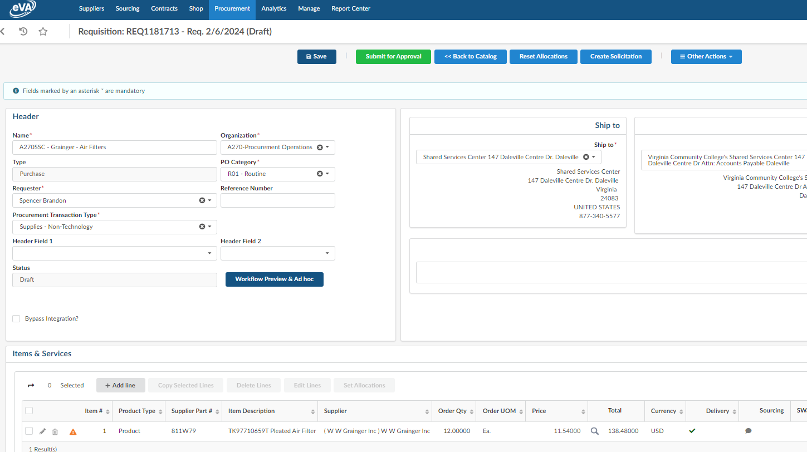
Create a Punchout or Catalog Requisition
You Made It: Click Green Submit for Approval Button

Slide 26
Section C
Catalog Item Requisition

Slide 27
Create a Punchout or Catalog Requisition
Now we are going to learn how to create a Catalog Item Requisition (a vendor loaded catalog into eVA) in the following steps:
Select the Shop tab
Select the Search Products option from the dropdown menu

Slide 28
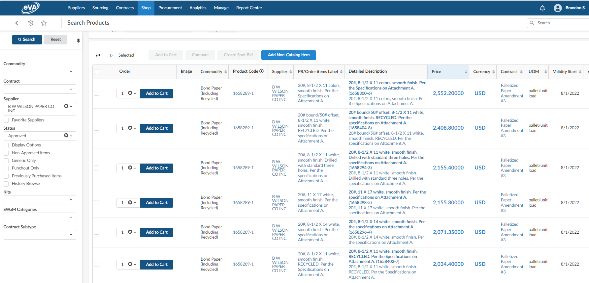
Create a Punchout or Catalog Requisition
Use filters to search for a supplier or contract.
View the Catalog items associated with the supplier. Note that these items are built into eVA and not an external catalog. Add to cart. View

Slide 29
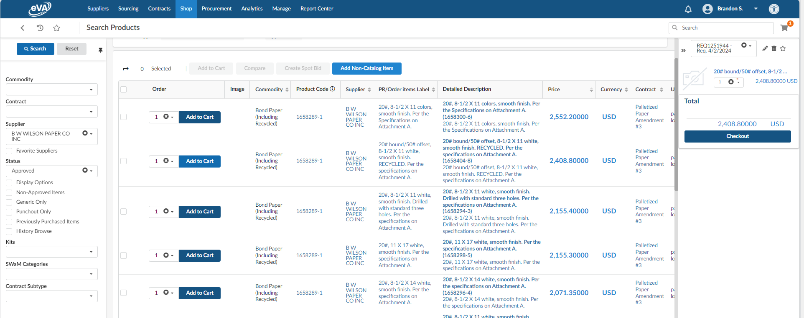
Create a Punchout or Catalog Requisition
A requisition number will be assigned that includes the item
Adjust quantity if necessary and click Checkout.

Slide 30
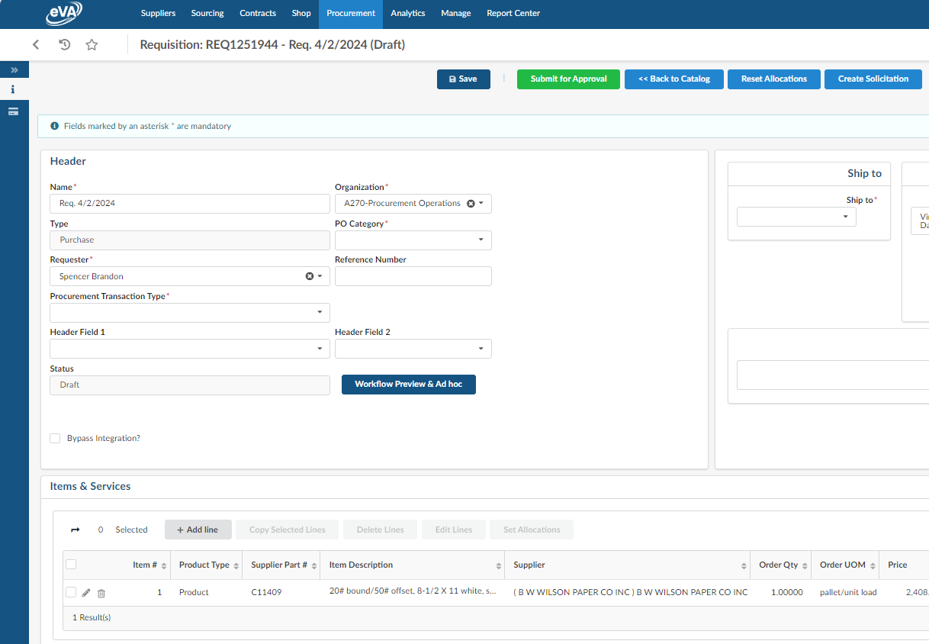
Create a Punchout or Catalog Requisition
The items will be pulled to a draft requisition. To complete your catalog requisition, follow the steps in section B, slides 19-25 of this training.

